Slide 1
ANDROID APPLICATION TO ADDRESS CIVIC ISSUES BY HELPING CITIZENS TO GET IN TOUCH WITH LOCAL AUTHORITIES
Team Members:
18B81A05G6-M.Shiva Nandh Reddy
18B81A05D2-T.Dheeraj Kumar
18B81A05F2-R.Rajesh Kumar
Supervisor:
Mrs. Meghamala

Slide 2
ABSTRACT
Cities all over the world are challenged with problems evolving from increasing urbanity, population growth, and density. Pointing to the complaints of the citizens in urban areas is a prime factor that can ensure the trust of different citizens. And it is difficult for the local governing bodies to look upon all the problems all the time. So in this project, it will help the common people under the jurisdiction of the Municipal Corporation to register their grievances day-to-day complaints in their ward through a mobile application. This application provides an interface to register one’s complaint and follow it up. It provides a camera module that helps to click up a picture of any problem that people are facing and upload its image along with the complaint. The location is tracked using Geotagging to know the coordinates of the location. Application display list of complaints registered which are got from the server.

Slide 3
INTRODUCTION
Direct communication between the local governing body and the citizen of that city is very efficient in solving the issue. But in India, there is no such way for getting a problem solved in our place we have to go through the hassles of registering the complaint to respective departments which in turn forward to the concern officers and then the problem get solved which takes a lot of time.
So the proposed system would be in which people can take pictures of the issues of the neighborhood and submit the picture along with details to a local government body, the complaint would be lodged along with the address of the issue with the local government which in turn can forward the problem to the appropriate department and the department will look after the issue. The citizens will be made available with the current status of the complaint and what action is being taken against it and how quickly the problem can be solved.
The main purpose of this project is to help the public by providing them a system that can be used for the betterment of the city and can make the city clean and problem-free as well as the citizen life easier.

Slide 4
BRIEF SURVEY OF LITERATURE STUDIED
FixMyStreet: is a website through which users can report potholes, broken street lights and similar problems with streets and roads in the United Kingdom to their local council or related organization, and see what reports have already been made. Capture, categorize and prioritize all the reported issues. •
SeeClickFix is a web tool that allows citizens to report non-emergency neighborhood issues, which are communicated to local government, as a form of community activism. It has an associated free mobile phone application.
The LBS API which is based on MLP(Mobile Location Protocol) allows Service Provider applications to send and receive location requests using a REST based API. Request Service enables the Service Provider application to request location of a particular mobile number and Idea Pro sends the location as a response.
OTRS (Open-source Ticket Request System) is a free and open-source trouble ticket system software package that a company, organization, or other entity can use to assign tickets to incoming queries and track further communications about them. It is a means of managing incoming inquiries, complaints, support requests, defect reports, and other communications. It is more than a mailing list notification system for ticket requests.

Slide 5
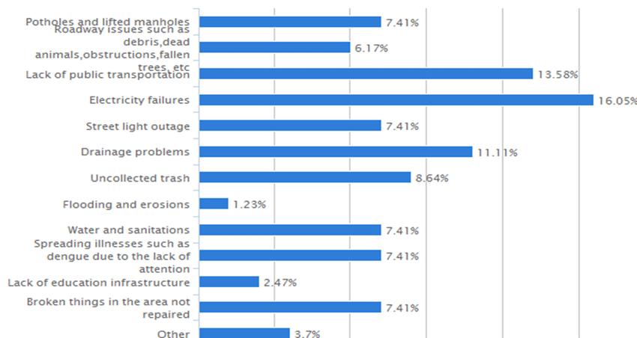
This graph shows the survey of the civic issues faced by the public in day-to-day life.

Slide 6
RELEVANCE
Possibility of setting questions by municipality, for various types of problems to report (all types of problems are configurable, as well as questions related to these themes, all set up also at the municipal level);
Sharing of all occurrences in various social networks;
Focus on citizens (civic points, sharing in social networks);
Promotes discussion on occurrences;
Prioritization system (more notoriety for most shared occurrences);
Definition of a control area (on which citizens can receive notifications of new occurrences) by the free demarcation of boundaries on a map.

Slide 7
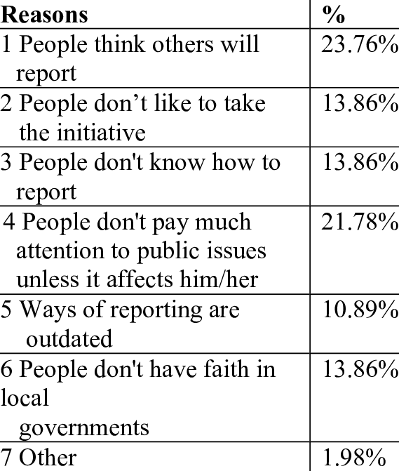
IMPORTANCE OF APPLICATION
People are reluctant about civic issues because many don't know how to complain about the issue and they leave it as it is. So this app can be the solution for them to complain about the issue to the governing bodies so that the problem can be solved as soon as possible.

Slide 8
FUNCTIONAL REQUIREMENTS
Geo-tag feature-User should be able to report the issue with a photograph with a geo-tag and a description.
Capture, categorize and prioritize all the reported issues. •
Reporting
1) Issues should be reported to the relevant local authorities. ➢
2) When the issue is fixed the system should be informed. ➢
3) Person who reported the issue should be informed when the issue is solved. •
Acknowledgement respective users ➢
1) Person when an issue is reported ➢
2) Local authority mentioning the time it would take to fix the issue while publishing in the website. •
Tracking the issues -All the users of the system also should be able to track the reported issues. •
Monitoring of the Issues- New issues, unattended issues, monitoring of issues, solved issues and closed issues should be categorized by the system.

Slide 9
NON-FUNCTIONAL REQUIREMENTS
Usability: Reporting procedure should be usable for the general public. The language used in the system must be unambiguous and according to the context.
Accuracy & Efficiency: All the information that is displayed in the system should be accurate. When a citizen reports a civic issue there should be an efficient mechanism in the system to direct the issue to the relevant authority and get solved with in the minimum time period. It shouldn’t consist of too many steps either.
Accuracy & Efficiency: All the information that is displayed in the system should be accurate. When a citizen reports a civic issue there should be an efficient mechanism in the system to direct the issue to the relevant authority and get solved with in the minimum time period.
Adaptability: System should adapt to any number of issues that come to the system.
Availability: It should be available for the users at any time from any place. If the available time gets increased, the number of users will be highly increased.
Reliability: Administrators should do a basic investigation of the issue and if there are evidences to prove only, that information should be displayed and direct to the local governments.
Scalability / Maintainability: In emergency situations, the system should be adaptable to bear huge amount of data. The system should be easy to maintain.

Slide 10
TOOLS TO BE USED FOR IMPLEMENTATION
Software Requirements:
Android Studio
XML
JQuery Mobile Framework
Camera Module\
Geotagging
Fire Base
Hardware Requirements:
Camera :12MP
RAM: 2GB
Secondary Storage: 50MB
Android Version:7.0 (Nougat) and above.

Slide 11
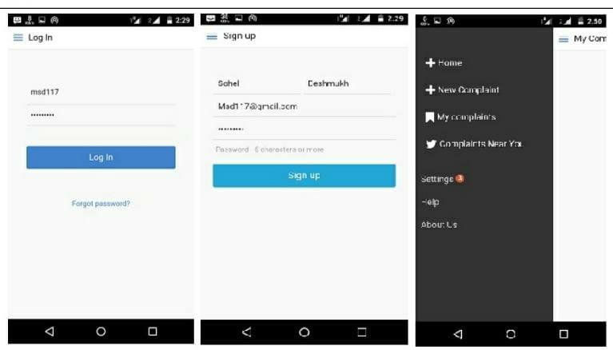
CASE STUDY

Slide 12
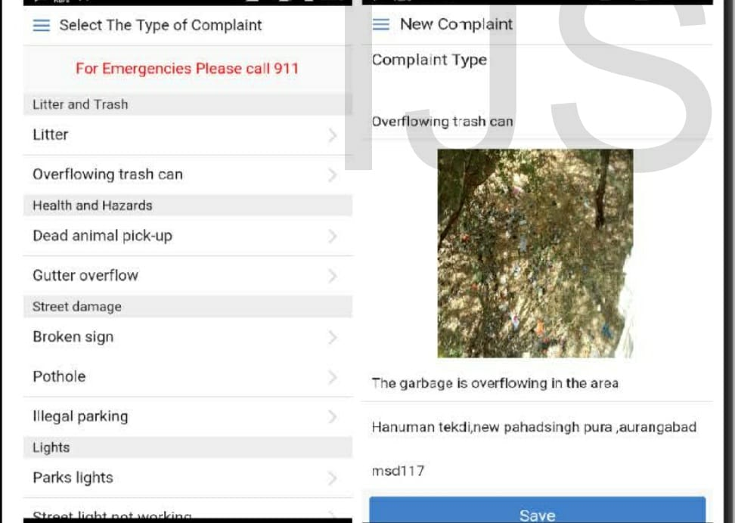

Slide 13
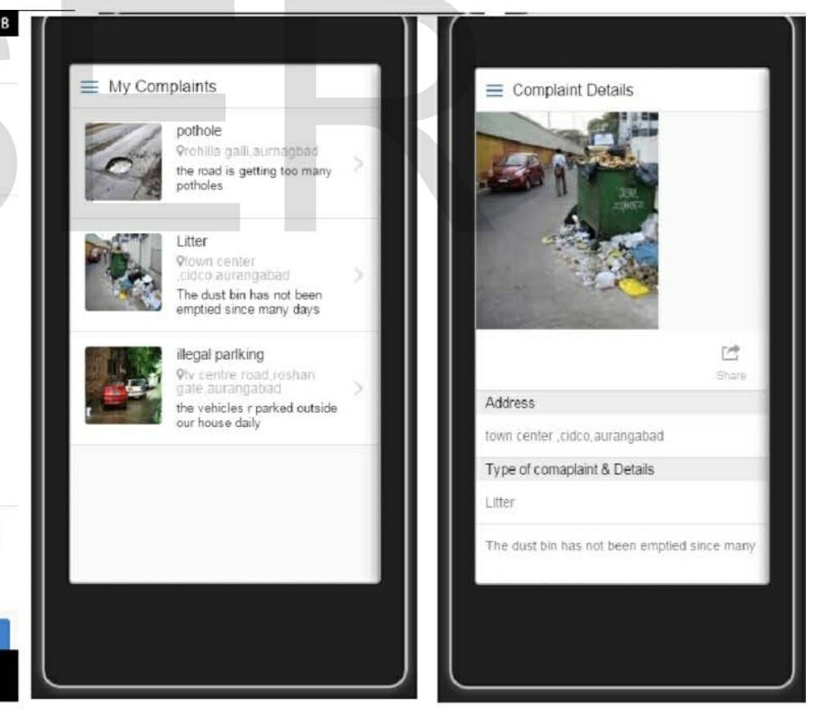

Slide 14
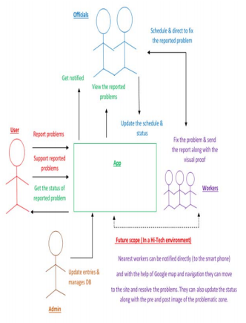
ARCHITECTURE OF THE APPLICATION

Slide 15
CONCLUSION
The implementation of a complaint system in a city has a potential to make a city operations more responsive and efficient, that will assist citizens with better utilization of services provided by Municipal Corporation within a particular area but such gains are entirely dependent on citizen participation. The direct communication between the municipal corporation and the citizen to help in registered problems that citizen facing in urban areas and by continuously track them will result in a clean, peaceful and good environment.
The significance of such application system would help in good governance It not only gives the local community confidence in its council, but improves the faith that elected members and officers have in their own local government and its decision-making processes. It also leads to better decisions, helps local government meet its legislative responsibilities and importantly provides an ethical basis for governance.

Slide 16
REFERENCES
Aurangabad Municipal Corporation (AMC): http://www.aurangabadmahapalika.org/complaint.jsp?i d=14 [Accessed: May. 17, 2015].
Citizen connect :Making Boston Beautiful http://www.cityofboston.gov/doit/apps/citizensconnect.a sp [Accessed: feb. 20, 2015].
Kumar, S.; Qadeer, M.A.; Gupta, A., "Location based services using android (LBSOID)," in Internet Multimedia Services Architecture and Applications (IMSAA), 2009 IEEE International Conference on , vol., no., pp.1-5, 9-11 Dec. 2009.
Swapnil R Rajput, Mohd Sohel Deshmukh and Karbhari V Kale. Article: Cross-platform Smartphone Emergency Reporting Application in Urban Areas using GIS Location based and Google Web Services. International Journal of Computer Applications130(12):27-33, November 2015. Published by Foundation of Computer Science (FCS), NY, USA.
JQuery Mobile “https://jquerymobile.com/” [Accessed:August 16,2015] [10] AngularJS:http://www.tutorialspoint.com/angularjs/ [Accessed: October2015] [11] https://onsen.io/blog/onsen-ui-tutorial-angularjsssentials-for-using-onsen-ui-part-1/ a. [Accessed:October2015] [12] https://developers.google.com/maps/documentation/geo coding/intro [Accessed:October2015]

Slide 17

Thank You

